Slide 1
Migrating Lekker Italia to AWS
Streamlining Operations with Cloud Technology
Praesignis AWS re/Start Project
Group 1

Slide 2
OVERVIEW
Agenda
01
About Lekker Italia
03
AWS Solutions
Restaurant overview and current operations
Recommended cloud services and architecture
02
Current Challenges
04
Cost Analysis
Operational pain points and inefficiencies
Monthly cost comparison and savings
05
Benefits & Conclusion
Why AWS is the right choice for Lekker Italia
Lekker Italia + AWS Migration
02

Slide 3
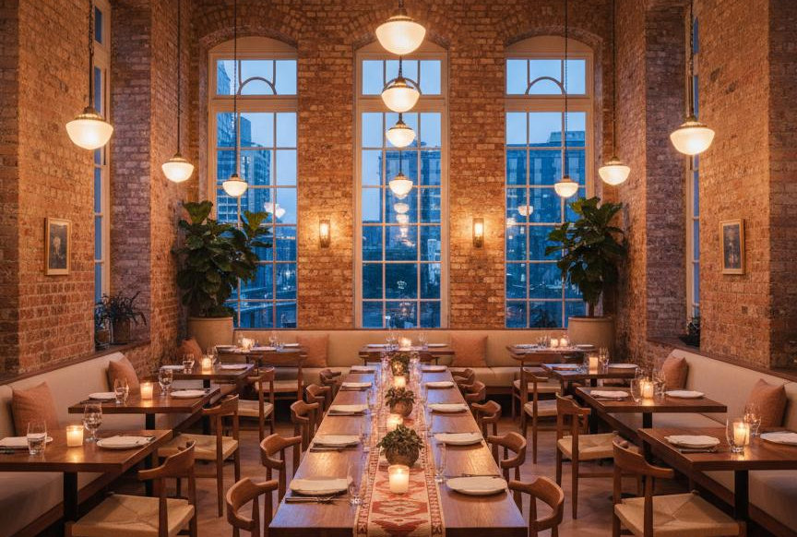
RESTAURANT PROFILE
About Lekker Italia
Lekker Italia is a beloved Italian-inspired restaurant in Cape Town, founded in 2015.
It serves handmade pasta, wood-fired pizzas, and artisanal desserts with locally-sourced ingredients.
With a loyal customer base, Lekker Italia receives a high volume of bookings and orders daily.
2015
150+
40+
Year Founded
Daily Customers
Menu Items
Lekker Italia + AWS Migration
03

Slide 4
PAIN POINTS
Current Challenges
Booking Chaos
No Customer Data
Paper Records
Scaling Costs
Manual booking leads to double bookings, mix-ups, and frustrated customers.
No centralized system to track preferences, history, or special requests.
Paper-based tracking causes delays and makes order retrieval difficult.
On-premise systems are costly and time-consuming to scale.
"The owner wants a simple website to allow online bookings and orders, reducing errors and improving efficiency."
Lekker Italia + AWS Migration
04

Slide 5
03
SOLUTIONS
AWS Solutions
How cloud technology transforms operations

Slide 6
AWS SERVICE
Amazon S3 — Website Hosting
99.99%
R0.37
Amazon S3 provides durable, scalable object storage. S3 hosts all website files and menu images with 99.99% durability.
Durability SLA
Per GB / Month
Use Case for Lekker Italia
Key Benefits
1. Upload website files to S3 bucket
2. Enable static website hosting
3. Connect CloudFront CDN
4. Configure Route 53 domain
Hosts HTML, CSS, JS and all image assets
Automatic scaling handles traffic spikes during peak hours
Low-cost storage at ~R0.37 per GB/month
Global content delivery via CloudFront CDN integration
SSL/TLS encryption for secure customer connections
Lekker Italia + AWS Migration
06

Slide 7
AWS SERVICE
AWS Cognito — User Authentication
For Lekker Italia Customers
AWS Cognito provides secure user sign-up, sign-in, and access control without managing a custom authentication server.
Create Account
Sign up with email or social login
Manage Bookings
View and modify reservations
Order History
Track past orders and preferences
Secure Access
Enterprise-grade encryption
Key Features
User registration and secure login system
Social identity providers (Google, Facebook)
Multi-factor authentication (MFA) support
Password recovery and email verification
Free tier: 50,000 monthly active users
Lekker Italia + AWS Migration
07

Slide 8
AWS SERVICE
Amazon RDS — Database Management
Data Stored for Lekker Italia
Amazon RDS provides a managed relational database for storing customer profiles, reservations, and order history.
Data Type | Use Case
Customer Profiles | Contact info, preferences
Reservations | Date, time, guests, status
Orders | Items, total, timestamps
Menu Items | Dishes, prices, categories
Key Features
PostgreSQL / MySQL engine support
Automatic backups and software patches
High availability with Multi-AZ deployment
Read replicas for improved query performance
Encryption at rest and in transit
Lekker Italia + AWS Migration
08

Slide 9
AWS SERVICE
AWS Lambda & SNS — Automation
Event Flow Example
AWS Lambda provides serverless computing for event-driven tasks. Combined with Amazon SNS, it automates notifications and workflows.
Customer Places Order
Automated Workflows
Lambda Processes Order
Send confirmation emails after bookings/orders
Notify staff about new orders via SMS/email
Trigger reservation reminders before dining
Process order analytics and reporting
No server management required — pay per execution
SNS Notifies Staff
Confirmation Sent
Lekker Italia + AWS Migration
09

Slide 10
FINANCIAL ANALYSIS
Cost Analysis
AWS Service | Monthly Cost | Notes
Amazon S3 | R32.60 – 81.50 | Storage + requests
CloudFront CDN | R81.50 – 163.00 | Global content delivery
AWS Cognito | FREE | Up to 50,000 MAUs
Amazon RDS | R244.50 – 407.50 | db.t3.micro instance
AWS Lambda | R0 – 81.50 | 1M free requests/mo
Amazon SNS | R16.30 – 48.90 | Email/SMS notifications
Route 53 | R8.15 | Domain management
ESTIMATED MONTHLY COST
R407–790
ON-PREMISES ALTERNATIVE
R3,260–8,150+
Server, electricity, maintenance, IT support
Potential savings: up to 90%
Lekker Italia + AWS Migration
10

Slide 11
WHY AWS
Key Benefits of AWS Migration
Cost Savings
Scalability
Reliability
Pay only for what you use. No upfront hardware costs or ongoing server maintenance.
Handle traffic spikes during peak dining hours automatically without manual intervention.
99.99% uptime SLA with automatic backups and disaster recovery built in.
Security
Global Reach
Innovation
Enterprise-grade encryption, compliance certifications, and secure access controls.
CDN delivers content fast to customers worldwide with low latency.
Access 200+ services for future enhancements like AI recommendations.
Lekker Italia + AWS Migration
11

Slide 12
SYSTEM DESIGN
Proposed Architecture
Customers
Route 53
CloudFront
S3 Bucket
Frontend Layer
Cognito
Lambda
RDS / DynamoDB
Backend Layer
SNS
Notification Layer
This serverless architecture minimizes operational overhead while maximizing performance and scalability.
Lekker Italia + AWS Migration
12

Slide 13
Ready to Migrate?
AWS provides the tools to transform Lekker Italia's digital presence. Start small, scale fast, and focus on what matters most.
Begin Your AWS Journey
Thank you for your consideration
Praesignis AWS re/Start Special Project

